Slide 1
Briefing
Customisable product
Use Briefing product simple or Briefing product complex
Menuez International B.V.

Slide 2

Briefing product simple
If there are several customisable products, please duplicate slide
A
A. Customisable header text field
B. Customisable subheader text field
C. Price adjustable to 4 digits
D. Packshot image library (see ‘coffees’ folder)
E. Food image library (see ‘food’ folder) with upload option
F. Customer logo with the option to upload or enter company name
B
C
D
E
F

Slide 3
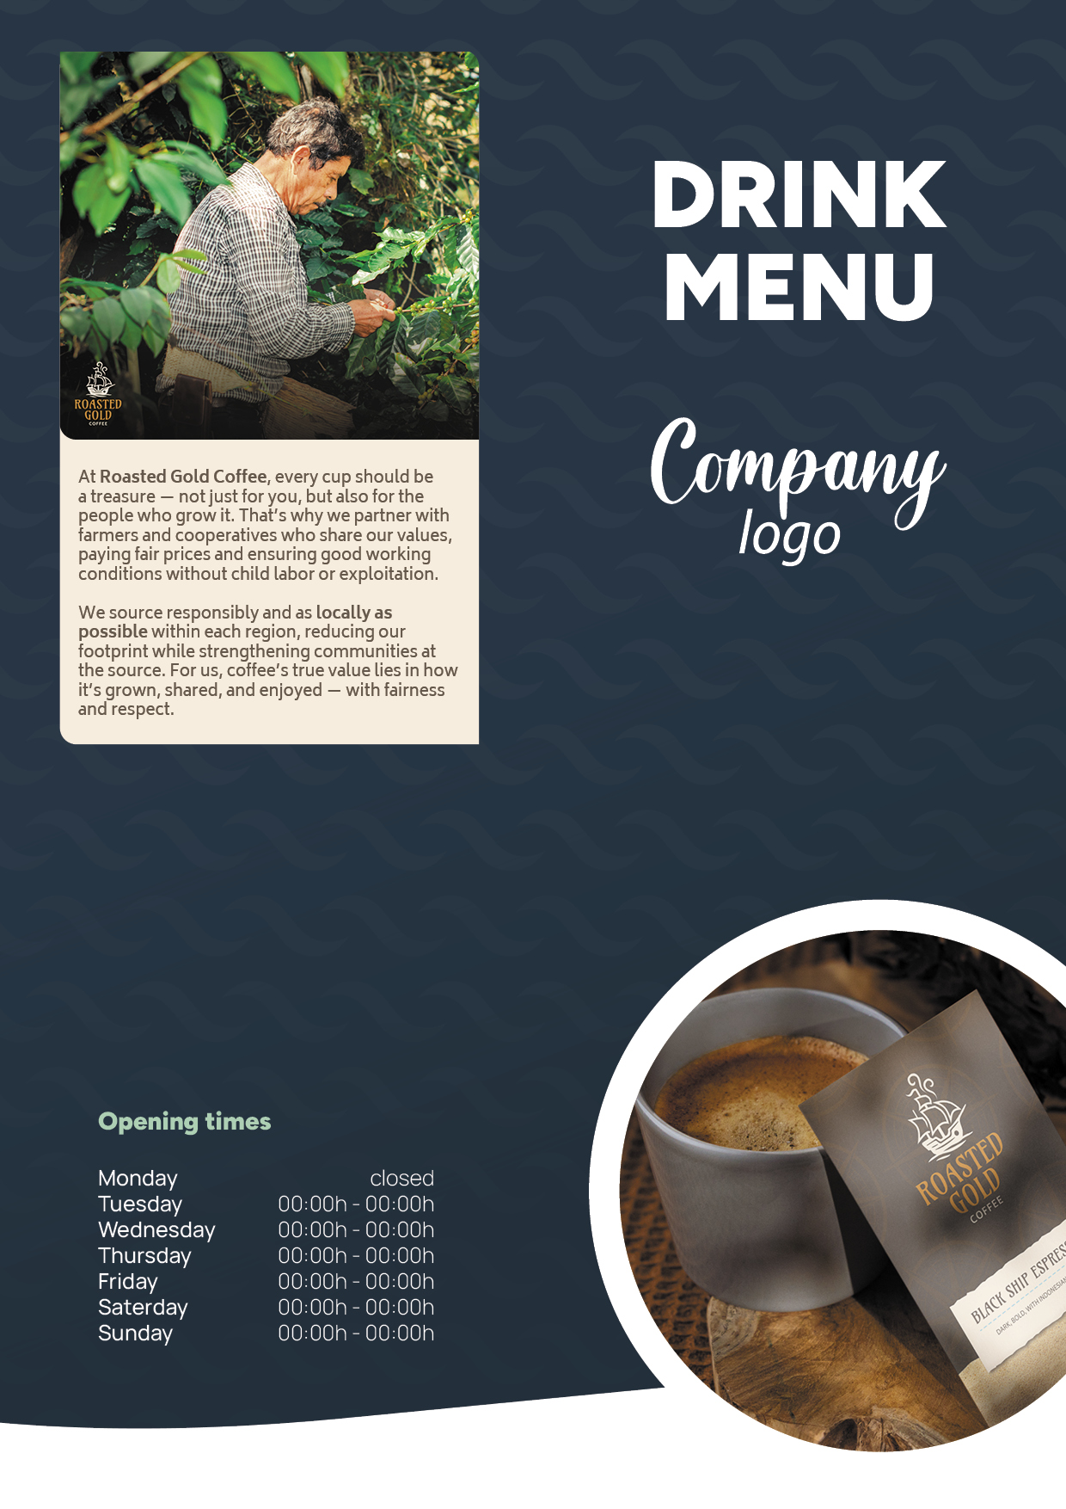
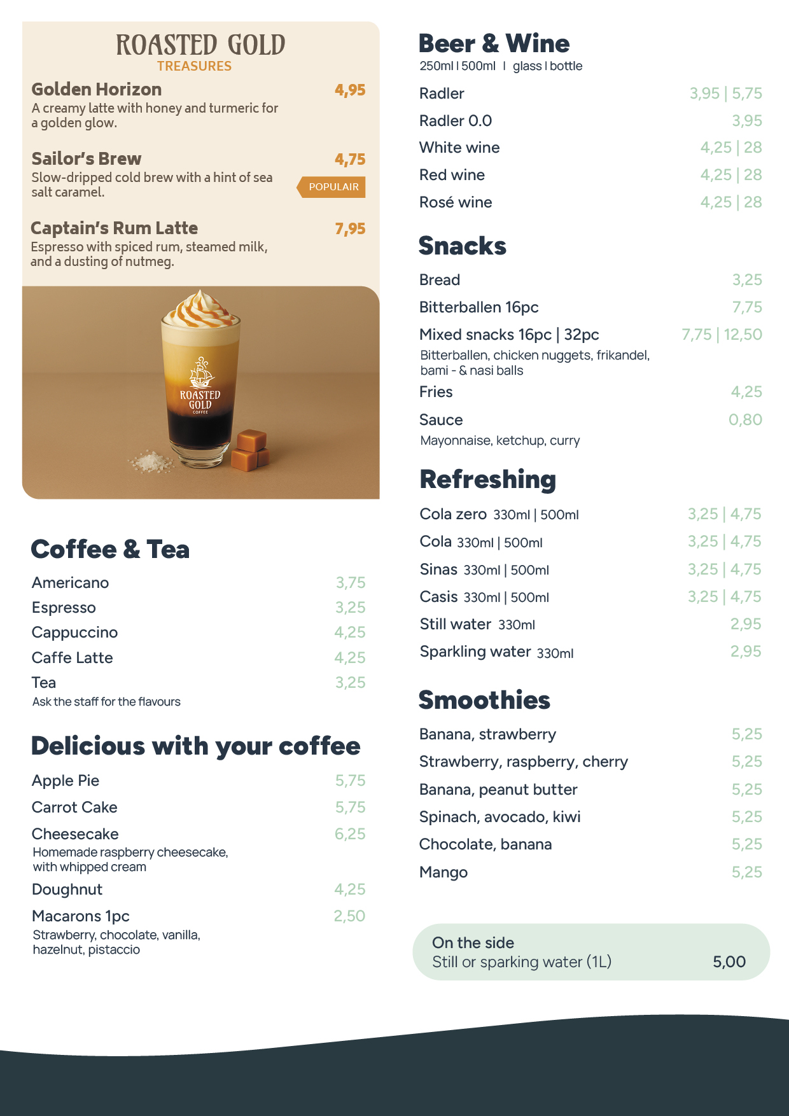
Briefing product complex
A. Customisable header text field
B. Customer logo with the option to upload or enter company name
C. Various design options (see ‘design’ folder)
D. Choose from 3 different storytelling options (see ‘story’ folder)
E. Option for opening hours
F. Image with upload option
G. Our assortment the first 2 products are fixed
H. image library our products (see ‘coffee’ folder)
I. Option for other customer product assortment
J. Featured product option
A
G
H
B
D
C
I
E
J
F

Slide 4
File submission specifications
Please provide an InDesign file in A0 format, including fonts and links, so that we can resize the file.
If an image library is required, all images must be supplied in high resolution (minimum 300 dpi).
Please clearly indicate whether there is an image library from which images (folder) may be selected
IDML file
Indesign file
Fonts
Links
Image libraries

